Slide 1
1. Handy glider
KTH Royal Institute of Technology, Sweden
International Physicist’s Tournament 2017

Slide 2
Problem statement
It is possible to make small gliders with paper and to make them fly for a very long time by putting your hand below the glider during flight. Explain the physics behind this phenomenon and describe the optimal set of parameters for the best control of the glider.

Slide 3
Problem statement, highlighted
It is possible to make small gliders with paper and to make them fly for a very long time by putting your hand below the glider during flight. Explain the physics behind this phenomenon and describe the optimal set of parameters for the best control of the glider.

Slide 4
Problem statement
It is possible to make small gliders with paper and to make them fly for a very long time by putting your hand below the glider during flight.
Explain the physics behind this phenomenon and describe the optimal set of parameters for the best control of the glider.

Slide 5
Problem statement
It is possible to make small gliders with paper and to make them fly for a very long time by putting your hand below the glider during flight.
Explain the physics behind this phenomenon and describe the optimal set of parameters for the best control of the glider.

Slide 6
Video example

Slide 7
Presentation contents
Delimitations and simplification
Description of aircraft
Basics of flight
Deflection of air by cardboard
Turning
Optimization of control
Definition of control
Effects of curvature
Experiments

Slide 8
Delimitations and simplifications
Single type of airplane
Flight only in calm air and at walking speeds
Initial use of cardboard (hands at end)
Notes:
(delimitation) Single type of airplane: the question is not asking us to design the optimal airplane, but to investigate the optimal way to use your hands to control the airplane
(delimitation) Flight only in calm air: it needs to be possible to fly at all
(simplification) Comparing hands with cardboard: cardboard easier to fly b.c. bigger surface area and easier to control

Slide 9
Description of aircraft
Glider design by http://www.sciencetoymaker.org/
Flaps to control turning
Swept-back wings
Angled surface
Slight V shape
Front weight

Slide 10
Description of aircraft: size comparison to hand

Slide 11
Flight basics
air body
glider
absolute glider velocity
absolute air body velocity
airspeed
airspeed = absolute glider velocity – absolute air velocity

Slide 12
Flight basics
Based on Updrafts and Downdrafts, NASA Glenn Research Center https://www.grc.nasa.gov/WWW/k-12/airplane/move4.html
Vertical direction
Still air
Updraft
Notes:
Glider always has to sink relative to the air body

Slide 13
Flight basics
Based on Updrafts and Downdrafts, NASA Glenn Research Center https://www.grc.nasa.gov/WWW/k-12/airplane/move4.html
Vertical direction
Still air
Updraft
Notes:
Glider always has to sink relative to the air body

Slide 14
Deflection of air by cardboard
Vertical direction
Incoming air is deflected: updraft is created
cardboard, hand etc.
Glider can only be controlled if flown close to the top edge!
(mutual observation of investigator and sciencetoymaker.org)

Slide 15
Simulations
Naivier-Stokes equations for stationary incompressible flow with no-slip boundary condition
$$ρ\left(u⋅∇\right)u=∇⋅\left[−ρI+\left(μ∇u+{\left(∇u\right)}^{T}\right)\right]+F$$
Simulated using COMSOL Multiphysics software
Notes:
To

Slide 16
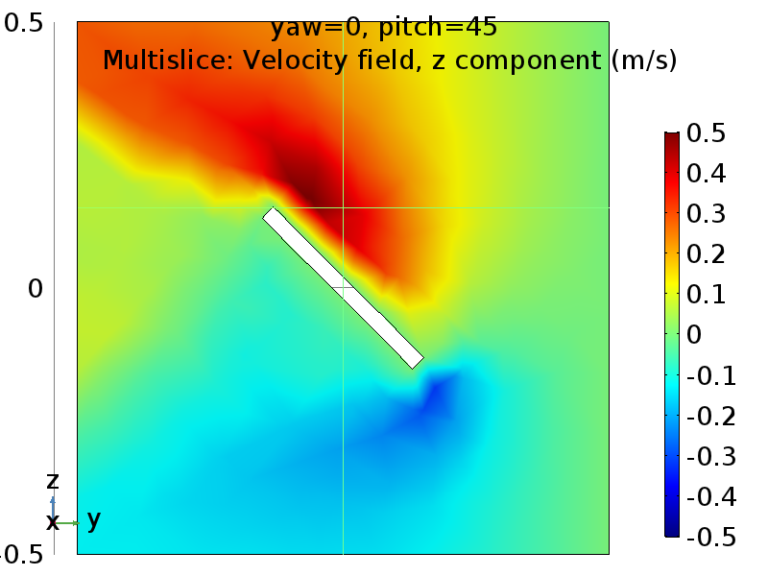
Air flow around cardboard
Direction of incoming air flow
speed: 1 m/s
z-position [m]
Notes:
Naivier-Stokes solver

Slide 17
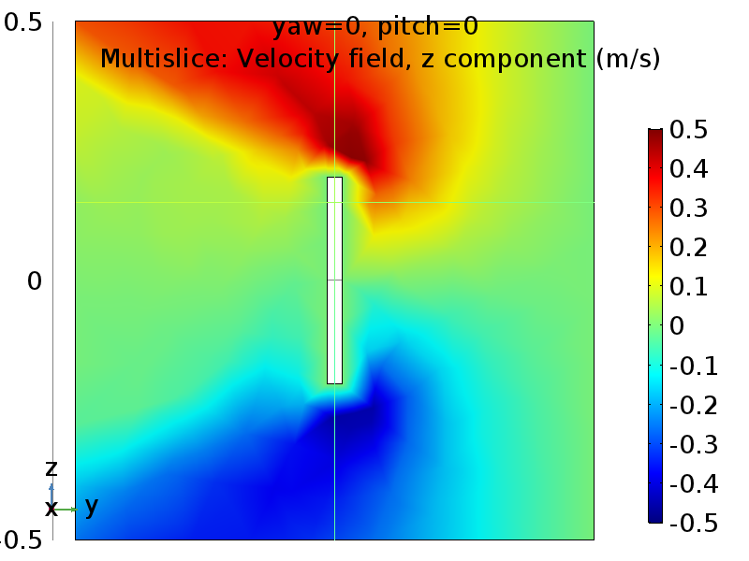
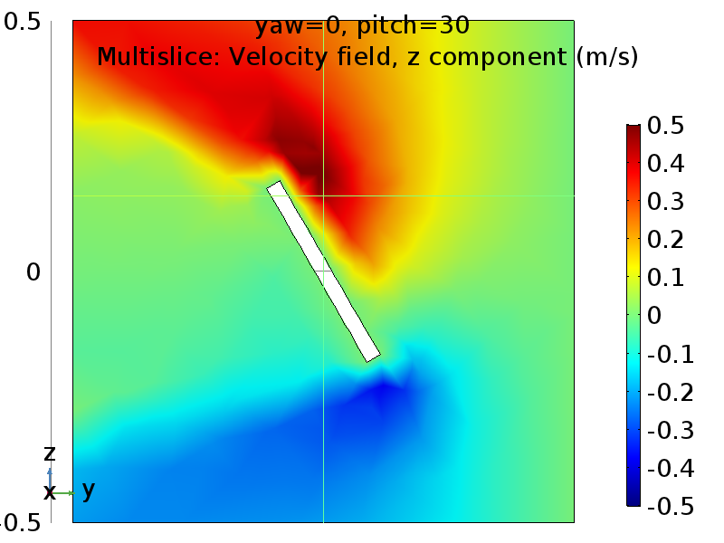
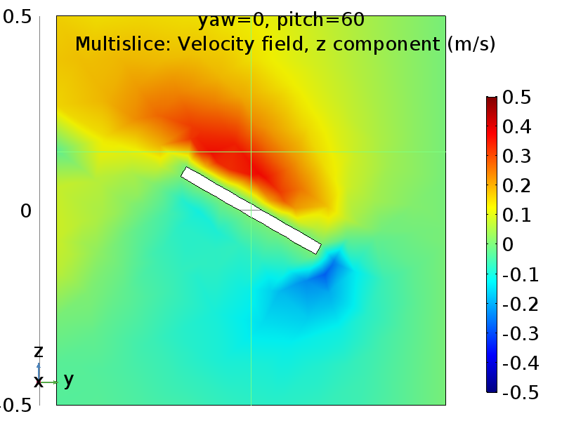
Comparison of angles
Air inflow of 1 m/s from right boundary
0
30
60

Slide 18
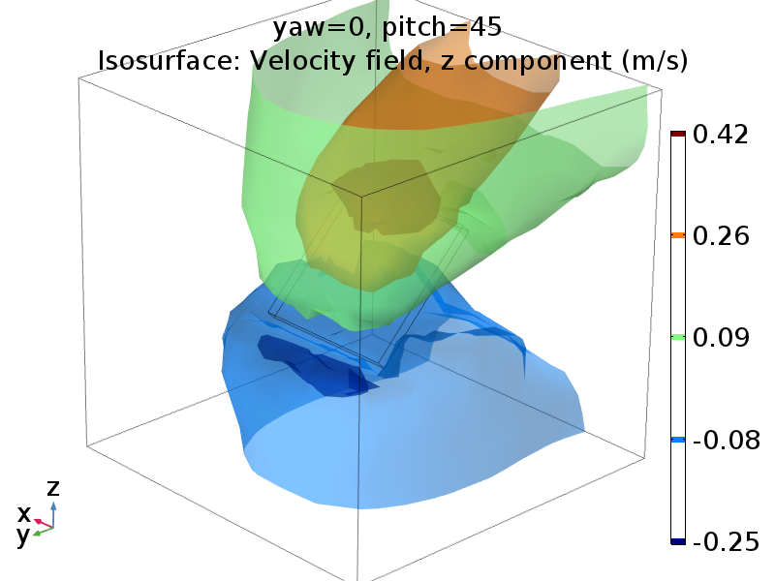
Zone of high updraft: source of control
Observed by sciencetoymaker as “sweet spot”
http://www.sciencetoymaker.org/airsurf/images/GLIDERS/FlyMosquitoGliderPDF.pdf
Notes:
This zone is what allows us to control the flight of the aircraft, by controlling the direction of lifting force on the aircraft

Slide 19
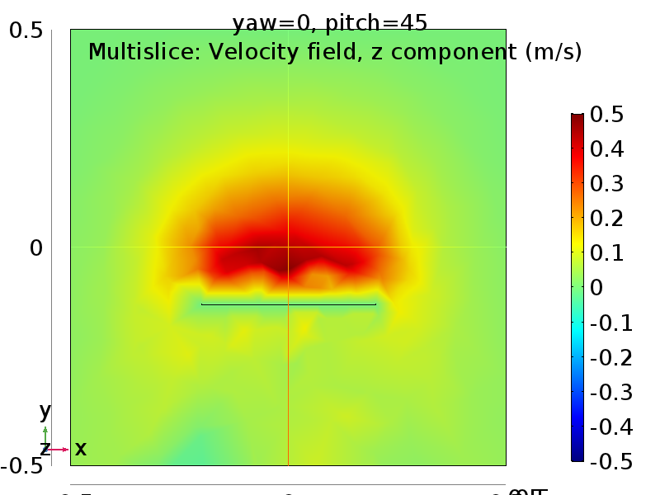
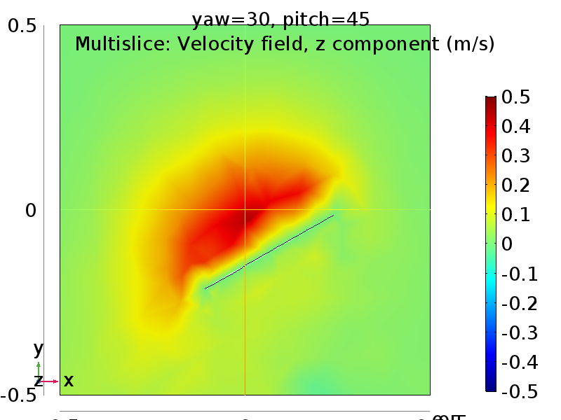
Effect of board yaw

Slide 20
Turning
Cardboard turned
Updraft not even over glider
Cardboard straight
View from above
force of lift
View from behind
updraft
Notes:
Force of lift deflected from vertical direction, gets horizontal component, causes plane to move in an arc

Slide 21
Implications
Well-defined zone of high updraft => good control
New objective: find shape of hands which gives largest updraft

Slide 22
Hand parameters
Orientation
Angle between hands
Angle from horizontal direction (pitch)
Spread of fingers
Hand curvature

Slide 23
Experimental setup
Anemo (=wind speed) meter, oriented vertically
Tubes to laminarize flow
Fan
Position of test person

Slide 24
Experimental setup
Qualitative testing to rule out parameters
Wind, 2 m/s

Slide 25
Hand parameters: Orientation
C showed most promise in qualitative tests. Arguments:
Effect on updraft indicator
Freedom of hand movement
B
A
C
View from behind
Notes:
We’re not saying it’s definitely the best, but we decided to use our time on this configuration

Slide 26
Hand parameters: Spread of fingers
Nano spread = the least the test person could spread fingers without them touching
Super spread = angle of 30 deg between long and pinky finger (max ability)
Error bars = range of observed values
Notes:
Spreading fingers reduce updraft

Slide 27
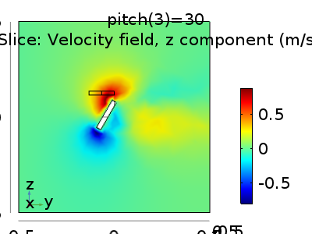
Hand parameters: pitch
measured angle
Experimental
Comsol simulation
Error bars = range of observed values
Notes:
The offset is the difference between how the probe used in Comsol works and how the Anemometer works
Comsol plots is the z-component like before. Measured comsol value is the maximum comsol speed
Hand moved forward to keep fingertips at the back of the anemometer: picture is misleading
Conclusion: 30 deg angle

Slide 28
Hand parameters: yaw
measured angle
z
y
z
x
y
x
Notes:
Peak at 45 deg, measurement error, correct value should be 1,1 by re-measurement

Slide 29
Hand parameters: bend
Notes:
Not very well defined, but hard to define and hard to define if you’re going to give recommendations to people

Slide 30
Conclusions
Hands should be held
parallell and vertical
30 degree pitch
medium curved/scooped
90-120 degree angle between hands
fingers kept together

Slide 31
Proposed experiment
test person
control zone
Flying in a defined path for as long as possible
Amount of control = time of flight
Clock is stopped when control is obviously lost or glider leaves zone
Vary configuration every two tests to counteract skill effects
path to follow
obstacle

Slide 33
Backup slides

Slide 34
No spread

Slide 35
Nano spread

Slide 36
Slight spread

Slide 37
Max spread

