Slide 1
HANDY GLIDER
Italian Team – Sebastian Fava
Notes:
Handy glider picture
Back up slide
Conclusive forces

Slide 2
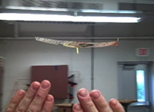
SUBJECT
It is possible to make small gliders with paper fly by putting your hand below the glider during flight.
Notes:
GENERAL COMMENTS:
less text + picture of a glider
during the presentation you show one

Slide 3
SUMMARY
Introduction on the Physics of Paper Planes
Experimental study
Parameters of the glider
Conclusions
PHYSICS OF
THE HANDY GLIDER
CONTROL PARAMENTERS

Slide 4
Physics of the
Handy Glider

Slide 5
FALL OF A FLAT PLATE^{[1]}
Force of Gravity
Air Resistance
[1] Y. NAKAYAMA, Introduction to Fluid Mechanics, p151, Tokai University, Japan

Slide 6
FALL OF A FLAT PLATE^{[1]}
Force of Gravity
Air Resistance
U
[1] Y. NAKAYAMA, Introduction to Fluid Mechanics, p151, Tokai University, Japan

Slide 7
FALL OF A FLAT PLATE^{[1]}
Force of Gravity
Air Resistance
U
[1] Y. NAKAYAMA, Introduction to Fluid Mechanics, p151, Tokai University, Japan

Slide 8
FALL OF A FLAT PLATE^{[1]}
Force of Gravity
Air Resistance
$mg=D=C_{D}A\frac{ρU^{2}}{2}$ ← Empirical law
U
[1] Y. NAKAYAMA, Introduction to Fluid Mechanics, p151, Tokai University, Japan

Slide 9
FALL OF A FLAT PLATE^{[1]}
Force of Gravity
Air Resistance
$mg=D=C_{D}A\frac{ρU^{2}}{2}$ ← Empirical law
$$U=\sqrt{\frac{2mg}{C_{D}ρA}}=\sqrt{\frac{2∙0.080 kg∙9,81 m/{s^{2}}}{1,13∙1,225 {kg}/{m^{3}}}}≃1,06 m/s$$
U
[1] Y. NAKAYAMA, Introduction to Fluid Mechanics, p151, Tokai University, Japan

Slide 10
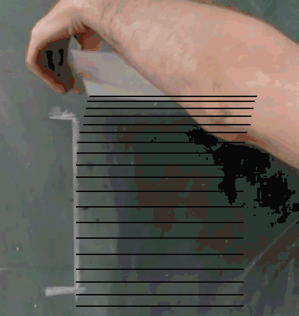
FALL OF A FLAT PLATE
$$speed:0.86±0.05 m/s$$

Slide 11
The paper sheet won’t move forward

Slide 12
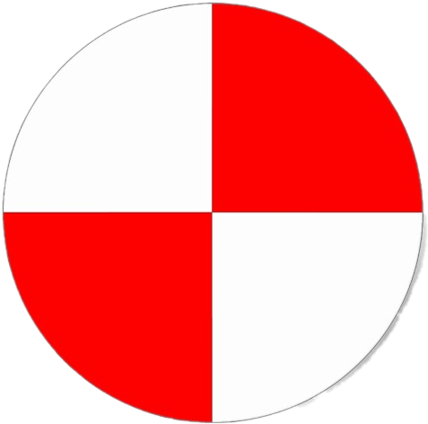
DIVING CONFIGURATION^{[2]}
Force of Gravity
Lift Force
L
W
[2] Y. NAKAYAMA, Introduction to Fluid Mechanics, p156, Tokai University, Japan

Slide 13
DIVING CONFIGURATION^{[2]}
Force of Gravity
Lift Force
α
W
[2] Y. NAKAYAMA, Introduction to Fluid Mechanics, p156, Tokai University, Japan

Slide 14
DIVING CONFIGURATION^{[2]}
Force of Gravity
Lift Force
L
α
W
[2] Y. NAKAYAMA, Introduction to Fluid Mechanics, p156, Tokai University, Japan
Notes:
Conservation of momentum law below

Slide 15
DIVING CONFIGURATION^{[2]}
Force of Gravity
Lift Force
L
U
α
W
[2] Y. NAKAYAMA, Introduction to Fluid Mechanics, p156, Tokai University, Japan

Slide 16
DIVING CONFIGURATION^{[2]}
Force of Gravity
Lift Force
Friction Drag
L
D
U
α
W
[2] Y. NAKAYAMA, Introduction to Fluid Mechanics, p156, Tokai University, Japan

Slide 17
DIVING CONFIGURATION^{[2]}
Force of Gravity
Lift Force
Friction Drag
Steady State:
$$\frac{L}{D}=\cot{\text{α}≃ \frac{1}{\text{α}}}$$
L
D
U
α
W
[2] Y. NAKAYAMA, Introduction to Fluid Mechanics, p156, Tokai University, Japan

Slide 18
FREE FALL
Steady State: Vz = 3.2 ± 0.3 cm/s
Vx = 1.4 ± 0.3 cm/s
angle = 3 ± 2 °
Notes:
D= ?
L= ?
L/D= ?
cot(angle)= ?

Slide 19
The paper sheet will move forward, but it will meet the ground eventually

Slide 20
RIDGE LIFT
Airflow deflected upward by an obstacle in his path, creating an ascendant push.
Effect exploited by gliders to allow long distance flights without thrust sources.
It performs work on the glider.
Ian Forster-Lewis, Efficient simulation of topographic lift in Microsoft Flight Simulator (FSX)

Slide 21
EXPERIMENTAL SET-UP
Transparent Window
Use of dry ice to visualize the airflow
Two experiments:
With the board alone
With both the board and the plane
Dry Ice
Camera

Slide 24
Control parameters

Slide 25
Weight
$$U=\sqrt{\frac{2mg}{C_{D}ρA}}∝\sqrt{m}$$

Slide 26
Weight
$$U=\sqrt{\frac{2mg}{C_{D}ρA}}∝\sqrt{m}$$
Stiffness increases with thickness

Slide 27
Weight
$$U=\sqrt{\frac{2mg}{C_{D}ρA}}∝\sqrt{m}$$
Stiffness increases with thickness
Compromise between light yet stiff materials

Slide 28
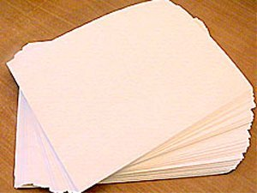
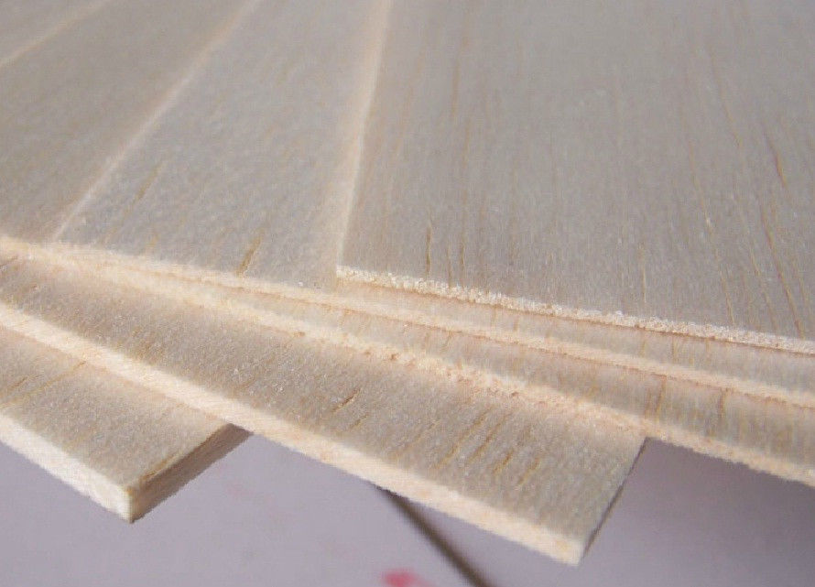
MATERIAL
Type [minum thickness]
PAPER [0.1 mm]
TWNA (Time Warp North America) [0.5 mm]
ATW (Asia Time Warp) [0.3 mm]
Balsa Wood [1 mm]
Surface density
80 $g/{m^{2}}$
56$g/{m^{2}}$
30 $g/{m^{2}}$
1$50g/{m^{2}}$
Stiffness
Very low
Great
Good
Excellent
Notes:
Show how different papers fall down

Slide 29
FRONT WEIGHT
Its aim is to induce diving
It’s ”adjustable” within a reasonable range
It causes an instability in the pitching plane
$$β=90°$$
$$β$$
Diving Stall
$$β=105°$$
$$β=75°$$

Slide 30
INSTABILITIES IN THE FLIGHT
Rotation axis of a paperplane

Slide 31
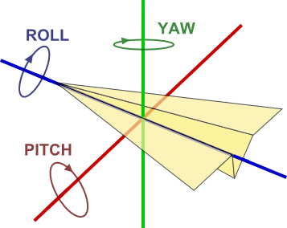
SHAPE
“Arrow shape” to lower the drag
Great Wing Aspect Ratio
STABLE EQUILIBRIUM IN THE ROLLING PLANE
$$γ=150°$$
$$γ$$

Slide 32
ELEVONS
Their role is to limit diving
Balance the effect of the font weight
STABLE EQUILIBRIUM IN THE PITCHING PLANE
$$δ=100°$$
$$δ$$

Slide 33
CAMBER
Enhance the back push
Increase the stability while turning
STABLE EQUILIBRIUM IN THE YAWING PLANE
$$β=130°$$
$$ε$$

Slide 34
SUM-UP OF THE PARAMETERS
Material → TWNA, 0.5 mm thick sheets, weighting $0,20 g$
Shape → “Arrow Shape” with head angle at $γ=\text{150°}$
Front Weight → one fifth of the weight of plane, bent at $β=\text{90° }\text{± 15°}$ (based on the desired angle of attack)
Elevons → 1 cm wide on the corners at $δ=\text{10}\text{0° }\text{± 10°}$ (depending on the previous parameter)
Cambers → 0.4 cm wide on the front line at $ε=\text{1}\text{3}\text{0°}$

Slide 35
BIBLIOGRAPHY
Nakayama, Y. (ed): Visualized Flow, compiled by the Japan Society of Mechanical Engineers, Pergamon Press, New York, 1988.
Ian Forster-Lewis, Efficient simulation of topographic lift in Microsoft Flight Simulator (FSX), University of Cambridge, 26th December 2007.
Glenn Research Center, Vector Balance of Forces for a glider, https://www.grc.nasa.gov/www/k-12/VirtualAero/BottleRocket/airplane/glidvec.html

Slide 36
Back-up
slides

Slide 37
Drag on a plate for laminar flow^{[3]}
$Re=\frac{Ul}{ν}=5∙{10}^{4}$
Laminar flow:
Turbolent flow:
$$D=C_{f}l\frac{ρU^{2}}{2}$$
$$C_{f}=\frac{1.46}{\sqrt{R_{f}}}$$
$$C_{f}=0.074R_{f}^{−1\backslash 5}$$
[3] Y. NAKAYAMA, Introduction to Fluid Mechanics, p156, Tokai University, Japan

Slide 38
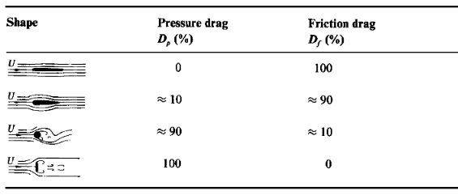
Aerodynamic forces

Slide 39
Material and weight
Type
PAPER
TWNA (Time Warp North America)
ATW (Asia Time Warp)
Balsa Wood
Density
500 ${Kg}/{m^{3}}$
1$1,2{Kg}/{m^{3}}$
6 ${Kg}/{m^{3}}$
1$50{Kg}/{m^{3}}$
Mass per sheet
1.7 g
0.20 g
0.13 g
6 g
Stiffness
Very low
Great
Good
Excellent
Notes:
Show how different papers fall down

Slide 40
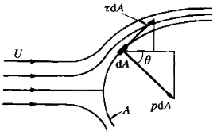
Aerodynamic forces
Pressure Drag
$$D_{p}=\int_{A}{p\cos{θ}da}$$
Friction Drag
$$D_{f}=\int_{A}{τ\sin{θ da}}$$

Slide 41
Flow over a plate
α=7º
α=3º
α=9º
α=15º
Streamline patterns for a flat plate at angle of attack. Nakayama, Y. (ed): Visualized Flow

Slide 42
Aerodynamic forces on a handy glider
Pressure Lift
L$=\int_{A}{p\cos{θ}da}$
α
Friction Drag
D$=\int_{A}{τ\sin{θ da}}$
α = angle of attack
α
Steady State:
$$\frac{L}{D}=\cot{\text{α}≃ \frac{1}{\text{α}}}$$
Glenn Research Center, Vector Balance of Forces for a glider

Slide 43
FRONT WEIGHT

Slide 44
Diving vs Stall Configuration

Slide 45
More exotic shapes

Slide 46
DIVING CONFIGURATION^{[2]}
[2] Y. NAKAYAMA, Introduction to Fluid Mechanics, p156, Tokai University, Japan

Slide 47
DIVING CONFIGURATION^{[2]}
[2] Y. NAKAYAMA, Introduction to Fluid Mechanics, p156, Tokai University, Japan

